Slide 1
Edited Image Detection
Sanshrav Arora
2021A7PS2690P

Slide 2
Introduction
Our project on advanced techniques for detecting edited images, with digital manipulation on the rise, accurately identifying altered images is crucial. Our approach uses Error Level Analysis (ELA), Convolutional Neural Networks (CNNs), Frequency Analysis and Gradient histograms to improve detection capabilities using the CASIA 2.0 dataset.

Slide 3
Initial Attempt
Detection of sudden changes in the light vector. Sudden changes in light direction vector may indicate that the image has been edited.
Problems:
Multiple light sources: may induce sudden changes in light direction vector and majority of images contain multiple light sources.

Slide 4

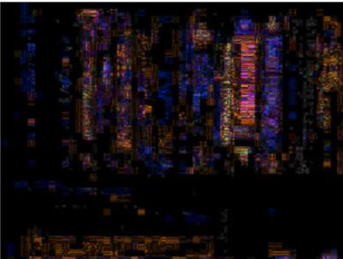
Solution found - using ELA
Error Level Analysis(or ELA) is a powerful method of checking if an image has been altered.
It uses the compression levels of an image to determine if an image has been edited or not.

Slide 5
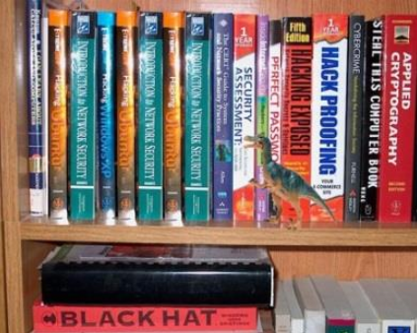
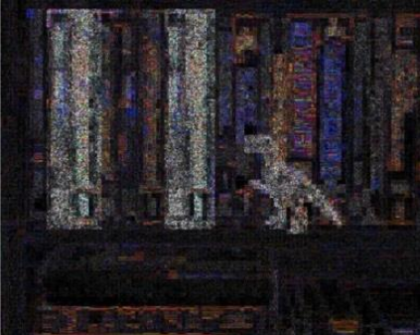
Edited image ELA

Slide 6
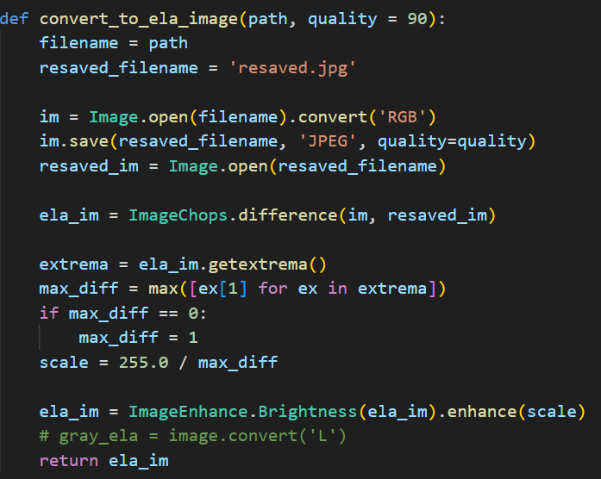
Approach of the Solution
Calculation of ELA of an Image:
Saving the image at 90% the original quality and taking the difference
Scaling of the image brightness as differences are really small

Slide 7
Dataset
Casia 2.0 Dataset has been used which contains:
7491 Real Images
5123 Edited images

Slide 8
Convolutional Neural Network Model
A CNN Model has been used which takes an input of an image and predicts if the image is Real or Fake.
Model description:
Convolutional Layers (2 layers)
Pooling Layer (1 layer)
Dropout Layer (2 layers)
Flatten Layer (1 layer)
Fully Connected Layers (2 layers)
Output Layer (1 layer)

Slide 9
Convolutional Neural Network Model
Convolutional Layers (2 layers): Extract intricate patterns, such as edges and textures, from input images. Hierarchical feature extraction enhances the model's ability to discern between authentic and manipulated regions.
Pooling Layer (1 layer): Down-sample feature maps, preserving essential information while reducing computational complexity. This operation enhances the model's efficiency and translational invariance.
Dropout Layer (2 layers): Mitigate overfitting by randomly deactivating neurons during training. This regularization technique fosters model robustness and generalization across diverse datasets.
Flatten Layer (1 layer): This layer transforms multidimensional feature maps into a one-dimensional array, facilitating seamless integration with densely connected layers. It prepares the extracted features for classification by reshaping them into a suitable format.
Fully Connected Layers (2 layers): These layers integrate the extracted features from convolutional layers and make informed classification decisions. By capturing complex relationships between features, they enable the model to learn intricate decision boundaries and classify images accurately.
Output Layer (1 layer): At the final stage, the output layer generates predictions based on learned features. It typically comprises neurons corresponding to the number of classes in the classification task and applies an appropriate activation function to produce probability distributions over the possible classes. This facilitates inference and decision-making, determining the authenticity of input images.

Slide 10
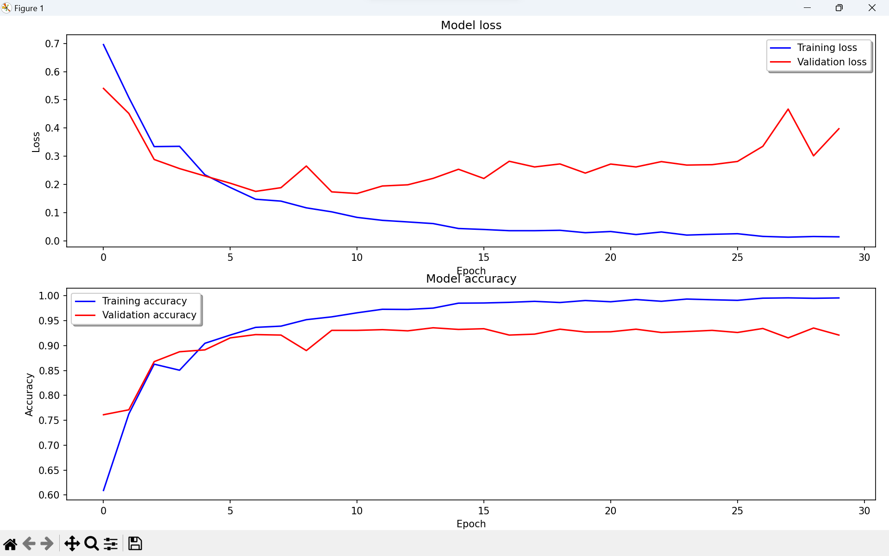
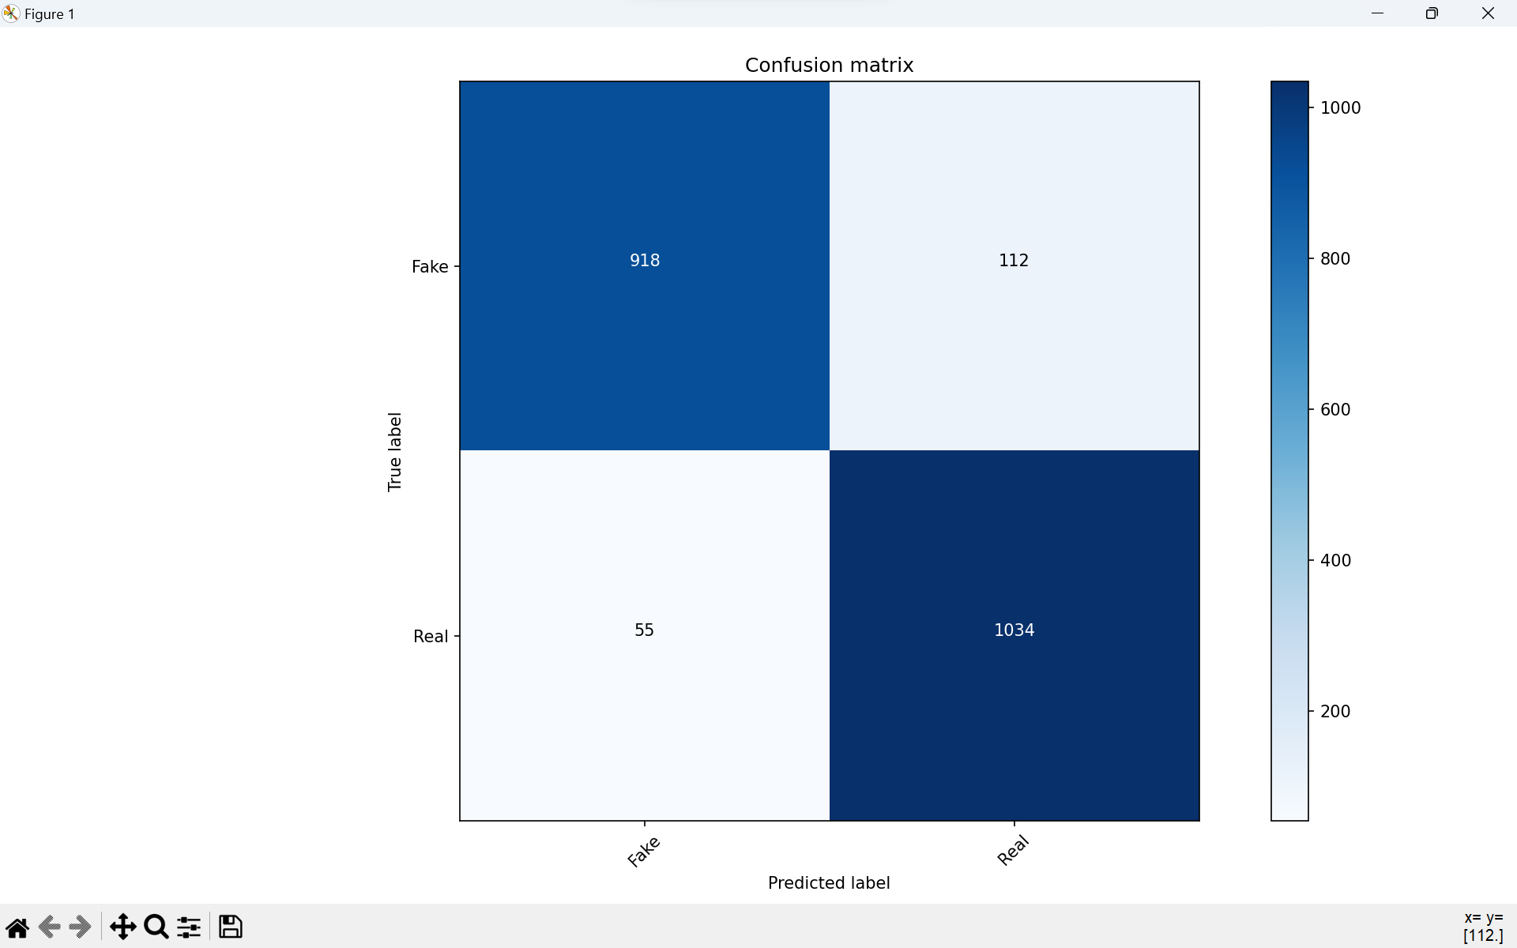
Results for the ELA-CNN attempt
After training the Model we were able to achieve an accuracy of 92.11% which can be seen in the Accuracy graph while training the model and the confusion matrix calculated by running the best model for the test data which is 20% of the data.

Slide 11
Problems Identified
The images classified in the ELA-CNN Model are limited to the dataset which contains only very bright and clean images. In real life photos can vary with lighting, can be noisy or blurry and the model sometimes fail to identify them or identifies them with low probability.

Slide 12
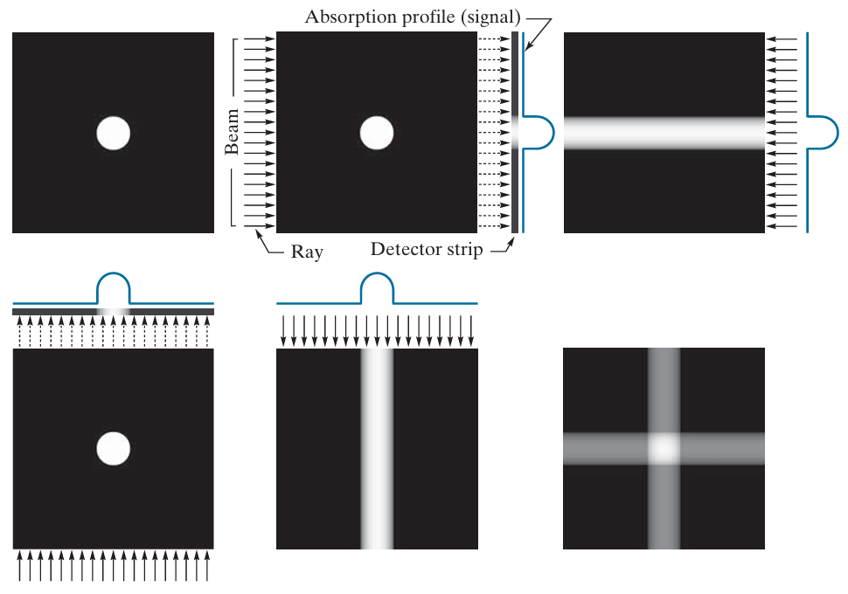
Image Reconstruction from Projections
In search of a solution I read about Image reconstruction from projections.

Slide 13
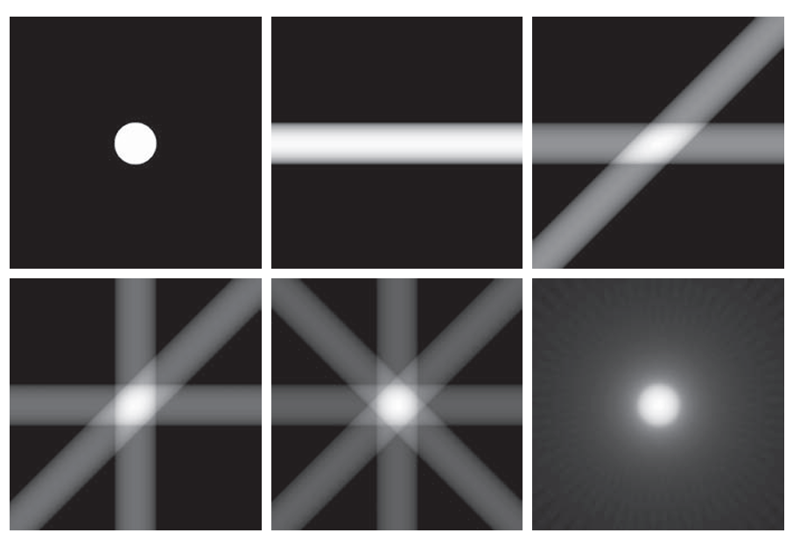
Image Reconstruction from Projections

Slide 14
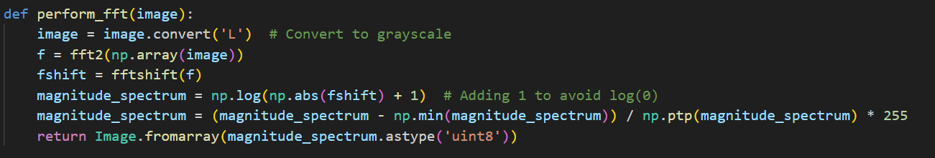
Frequency Analysis
Editing Images can create inconsistencies in the frequency domain, noticeable as irregular patterns when compared to natural images.
Performing Fast Fourier Transform on the Image.

Slide 15
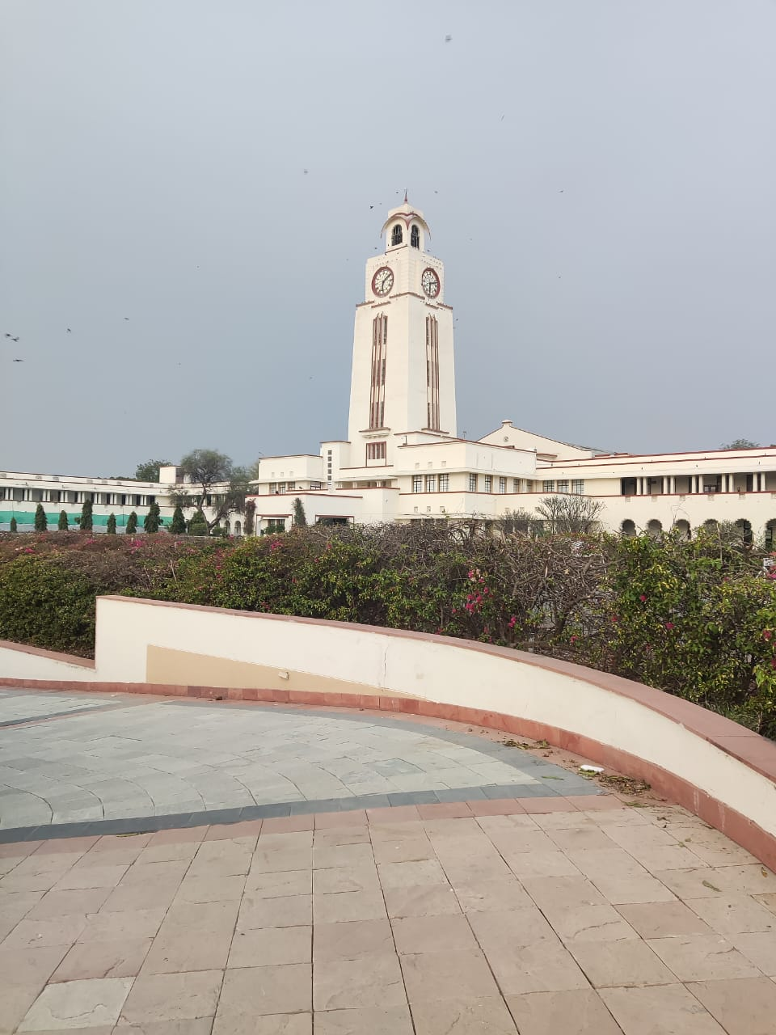
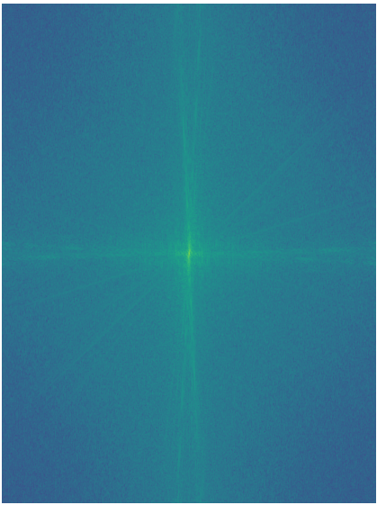
Fast Fourier Transform Example

Slide 16
ELA with FFT
Tried to make a dual input CNN model, with both ELA and FFT of the image as input and prediction of image being real or fake as the output.

Slide 17
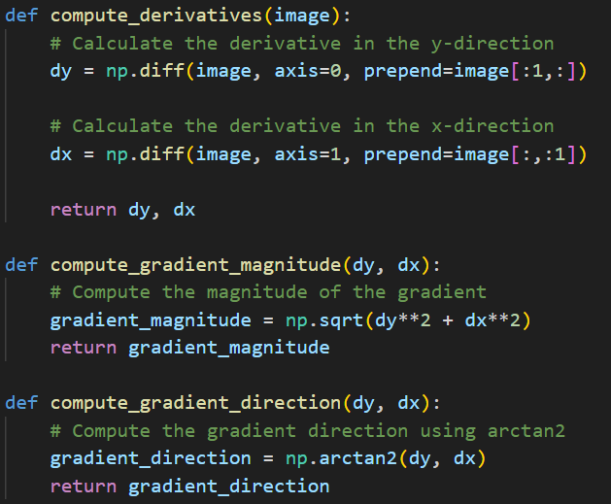
Image Gradient - Magnitude and Direction
Calculated the Image’s first derivative across the x direction and y direction.
And used the derivatives to calculate the magnitude and direction.

Slide 18
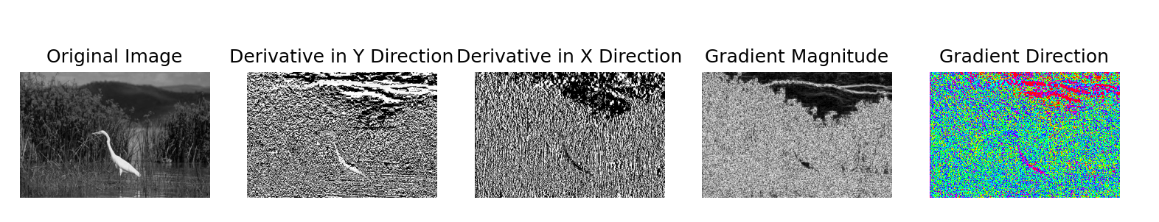
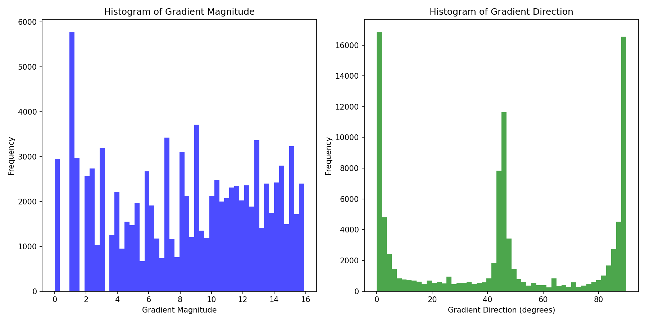
Image Gradient - Histogram of Real Image

Slide 19
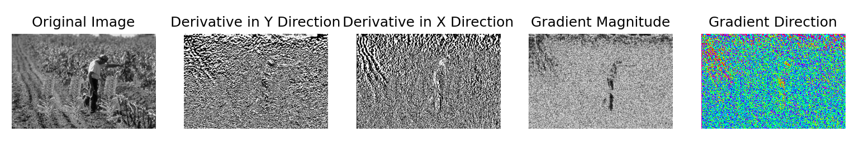
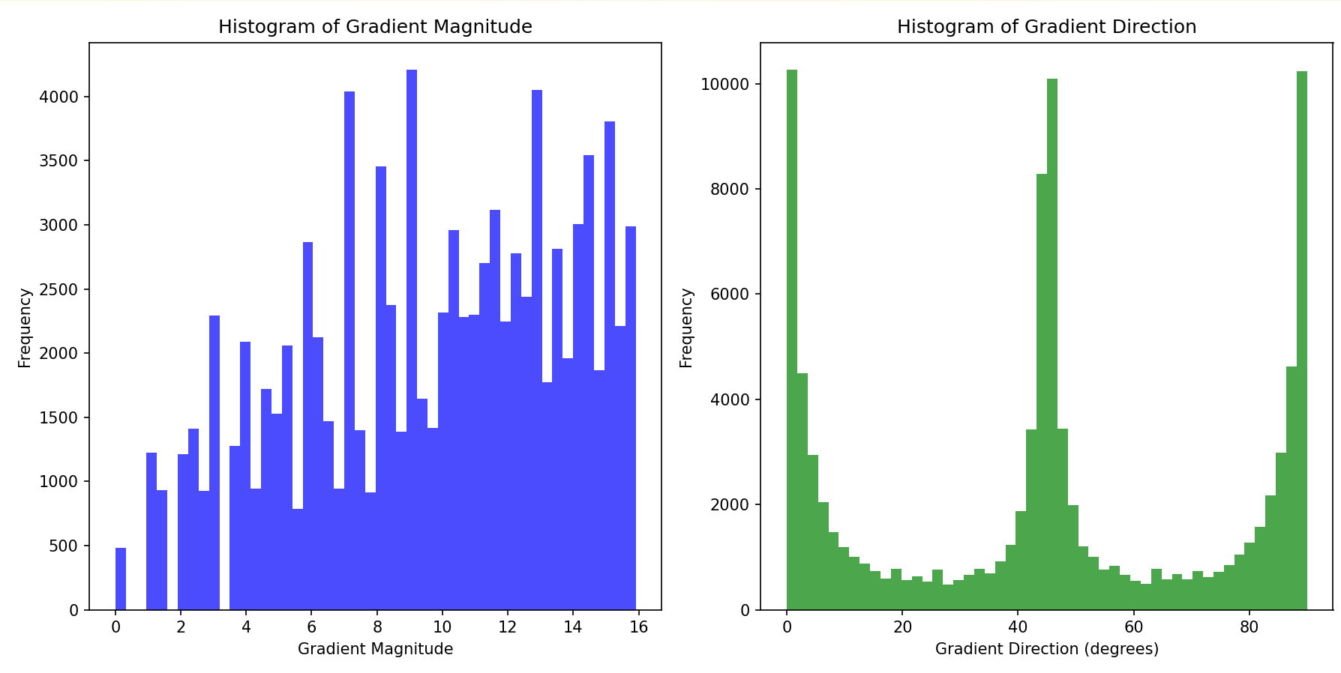
Image Gradient - Histogram of Fake Image

Slide 20
Segmentation of Images
Segmented the image of size N*M into C squared images of size (N/c)*(M/c), and plotted the same gradient histograms.

Slide 21
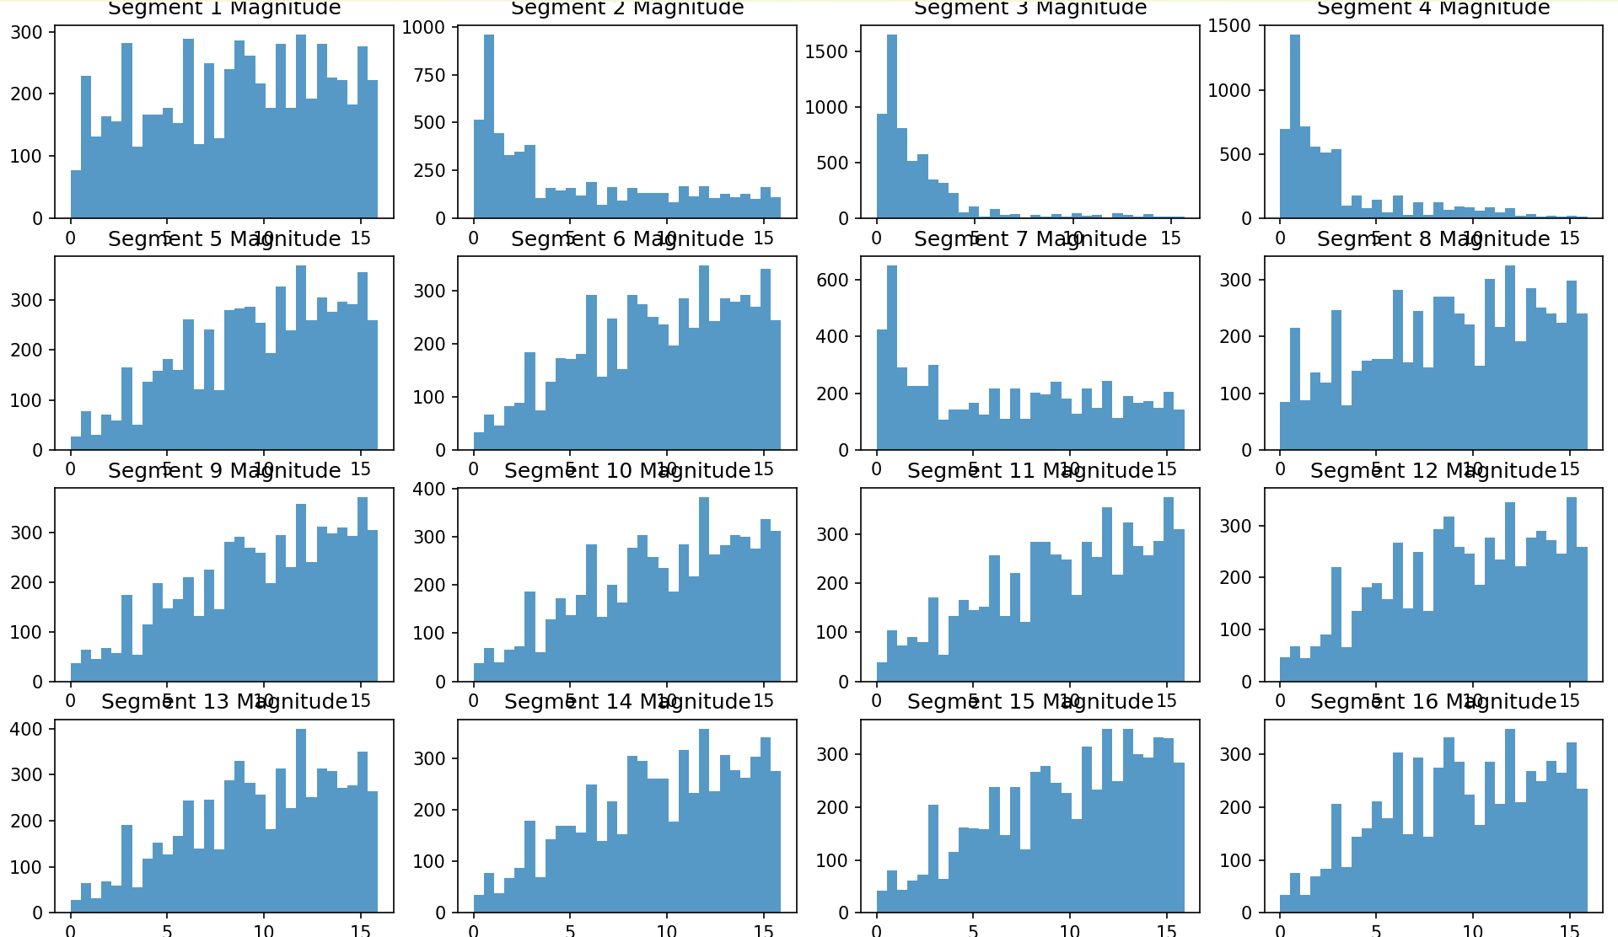
Segmentation of Images - Real image - Magnitude

Slide 22
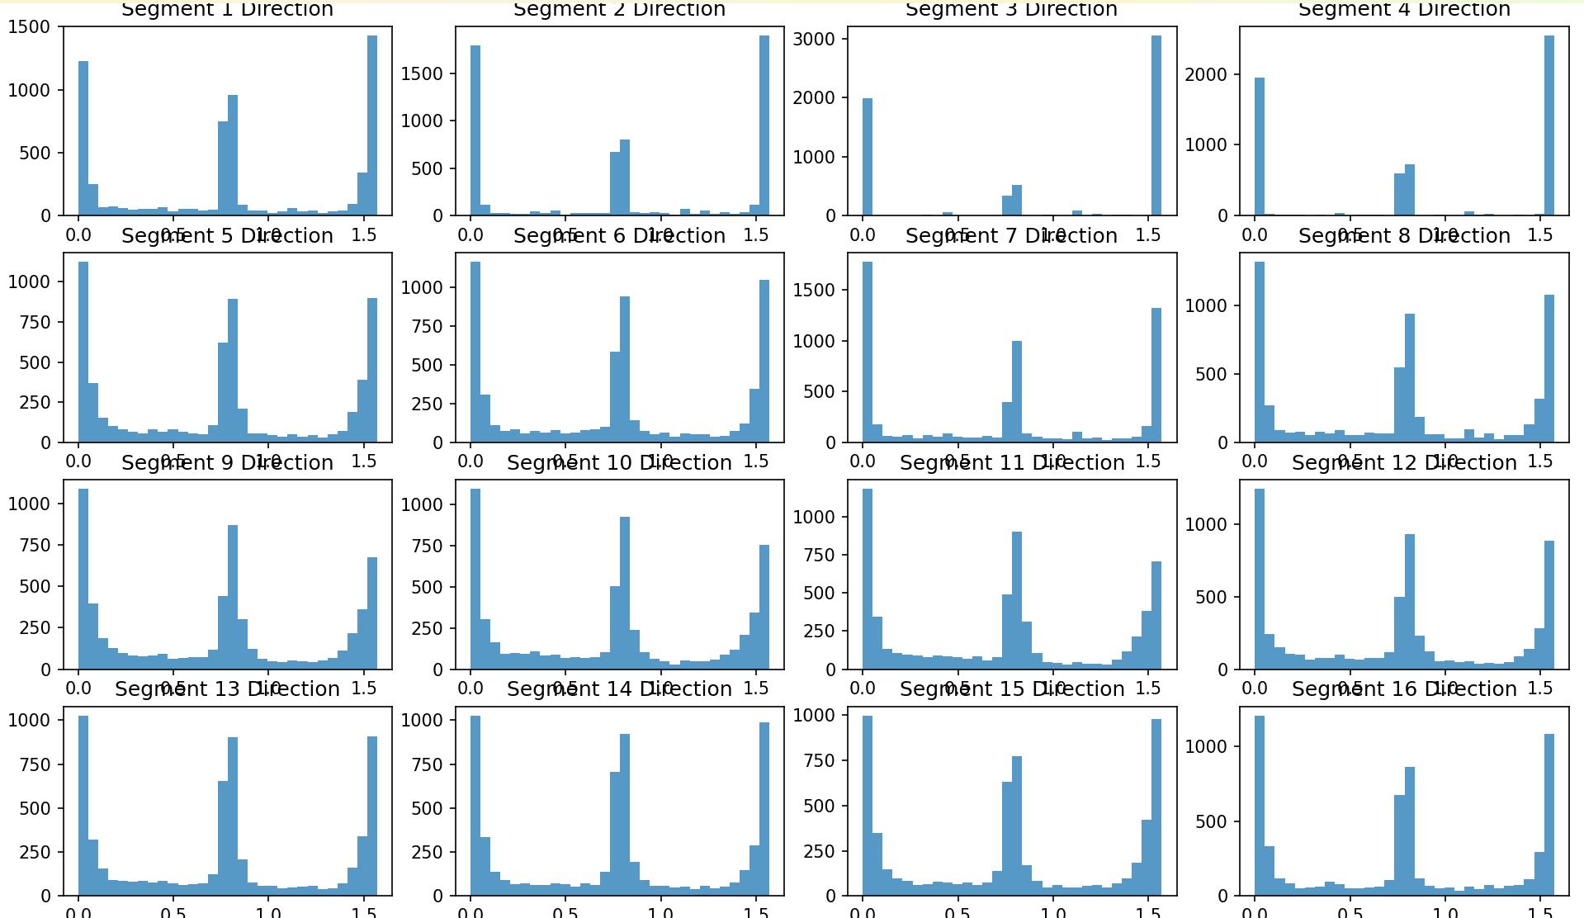
Segmentation of Images - Real image - Direction

Slide 23
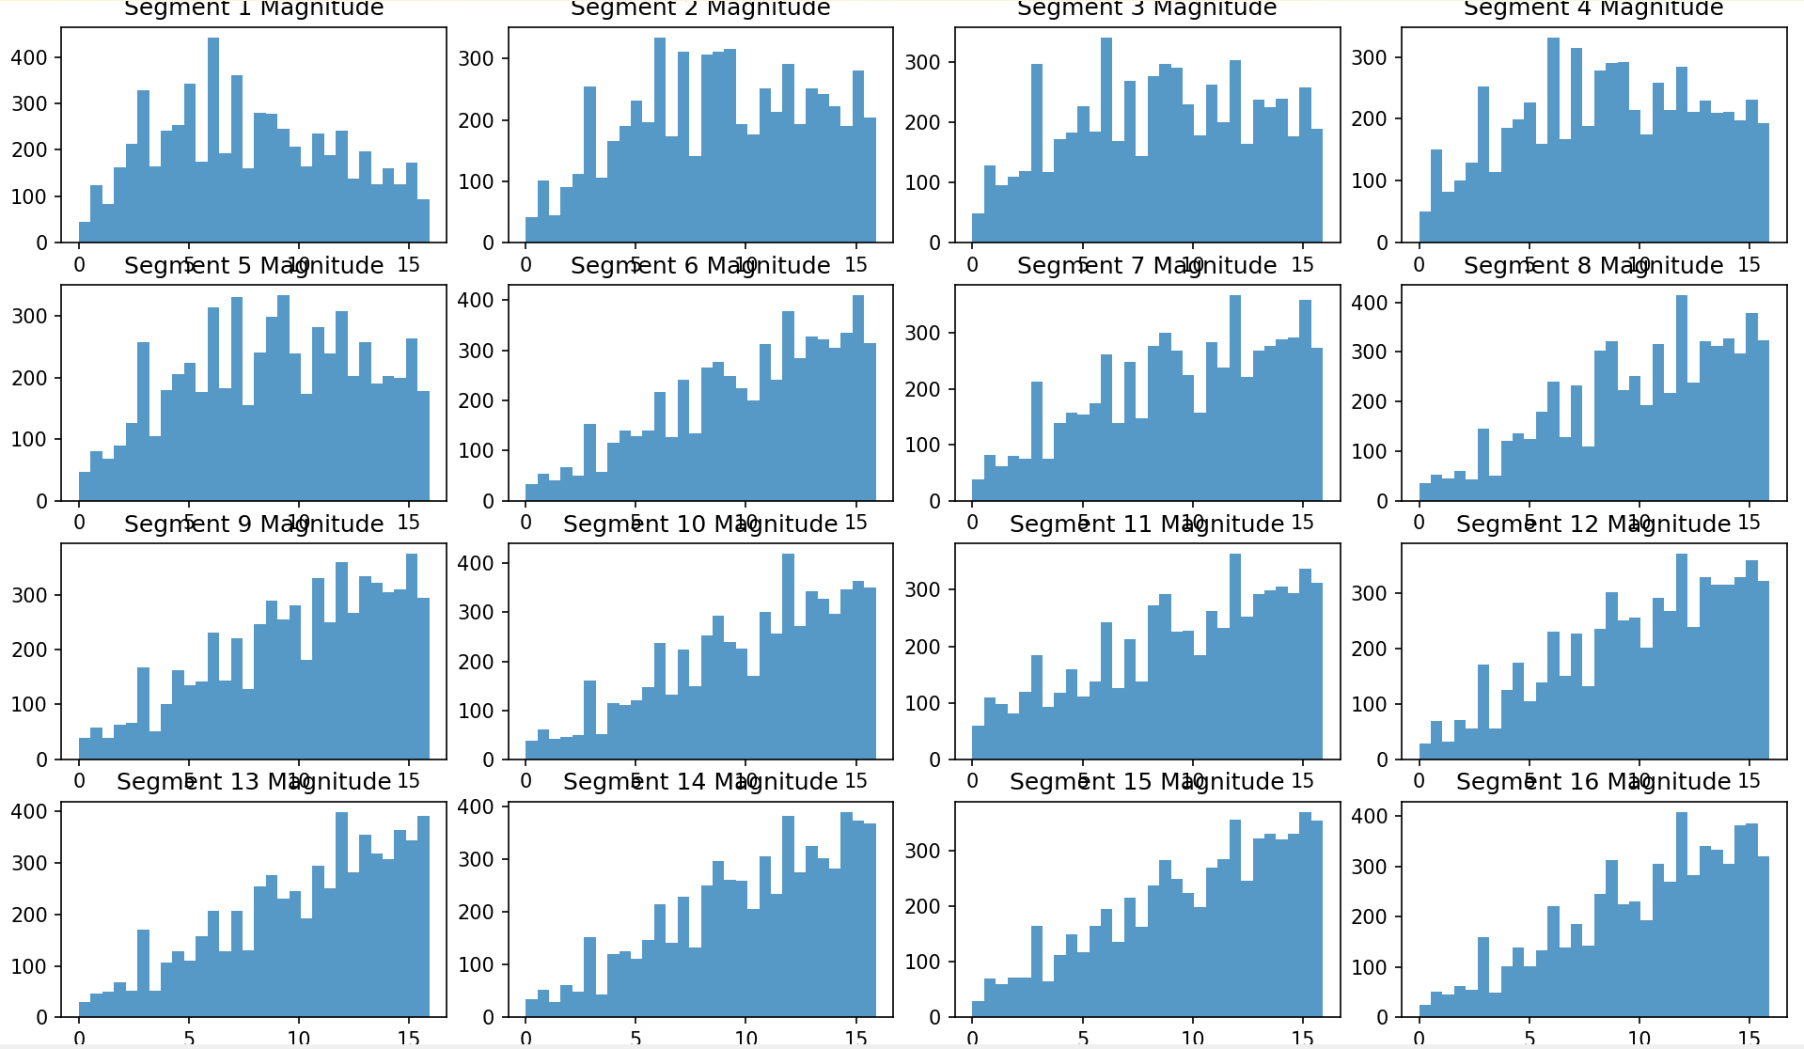
Segmentation of Images - Fake image - Magnitude

Slide 24
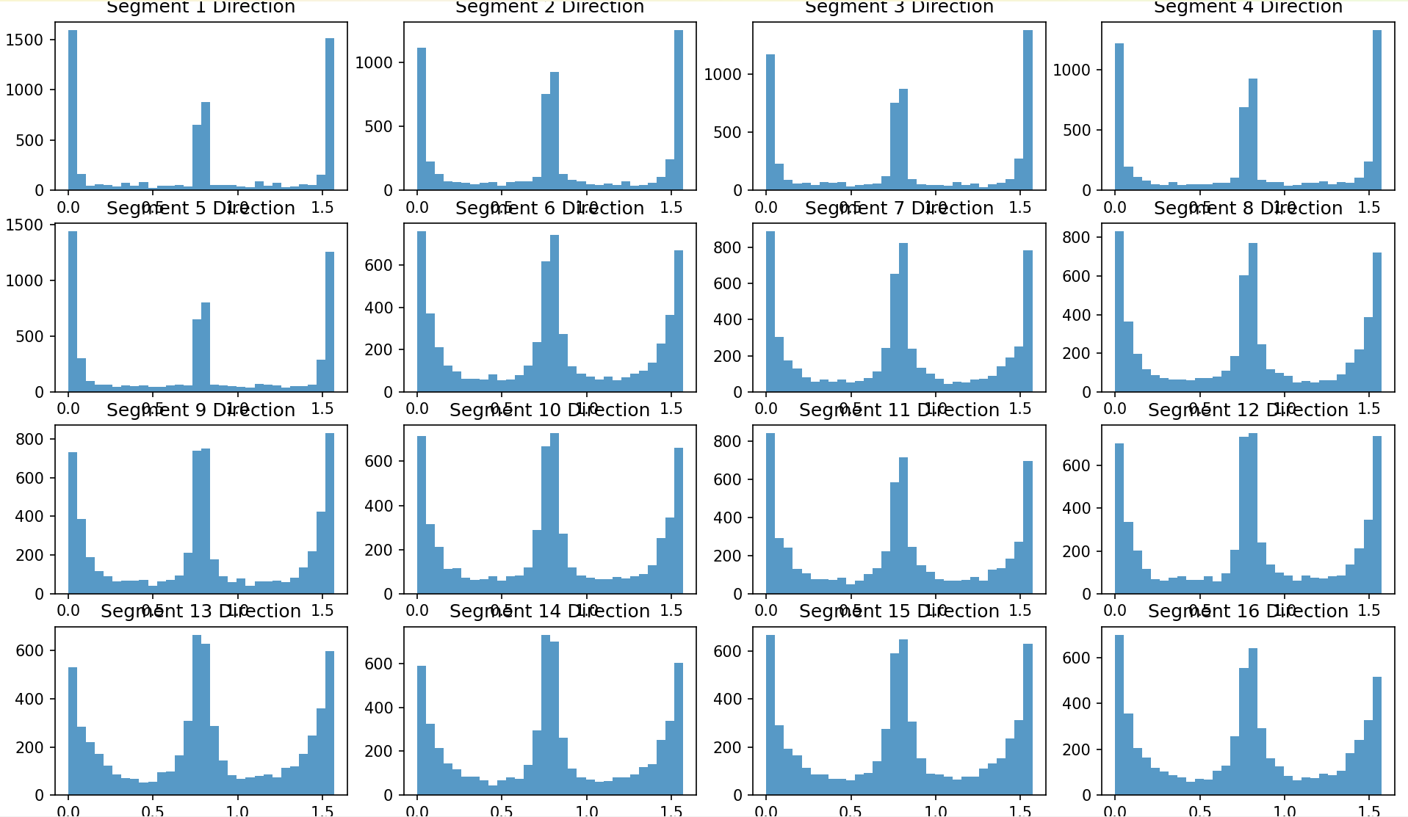
Segmentation of Images - Fake image - Direction

Slide 25
Conclusion
In summary, our research on detecting edited images has been quite successful, achieving an impressive accuracy of 92.11%. Our integration of ELA, CNNs, enhances the reliability of digital media verification. And by adding image gradient analysis, frequency analysis or image reconstruction can be increased further in the future to classify all kinds of Images correctly.

Slide 26
THANK YOU!

